Slide 1
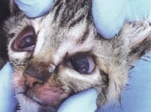
Feline Panleukopenia
Allison Maddox

Slide 2
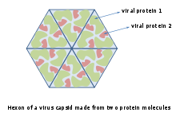
Etiology
Pansystemic Disease – affects multiple body systems
Autonomous Parvovirus - independent organism
Non-enveloped, single-stranded DNA virus
AKA Feline Distemper
Closely related to Canine
Parvovirus, type 2 and Mink Enteritis

Slide 3
History
Studies in the 1930’s & 1940’s showed that the parvovirus was the cause of Feline Panleukopenia
During this time, many wild felids that were held in captivity died of this disease
Virus was first isolated in the tissue of domestic cats in the late 1950’s
FPV is the prototype of many related parvoviruses, including canine parvovirus
In 1978, canine parvovirus type 2 was discovered and believed to have evolved from FPV.

Slide 4
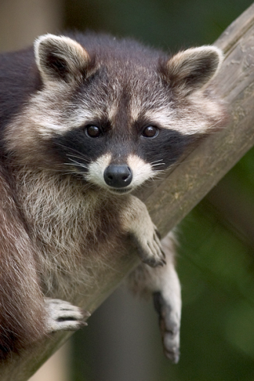
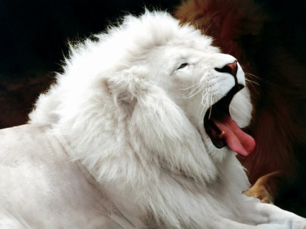
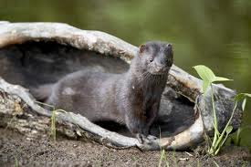
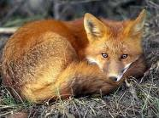
Signalment
Infects all felids, raccoons, mink, and foxes
Cats of all ages, kittens are most susceptible
Males and females are equally susceptible

Slide 5

Transmission
Not zoonotic
Via fecal-oral route
Virus can live for more than one year in the environment
Transported via fomites

Slide 6
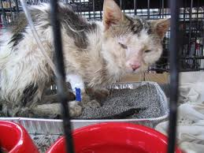
Clinical Signs
Diarrhea (possibly bloody)/vomiting
Fever of 104 to 107 degrees F
Dehydration
Depression
Anorexia
Decreased WBC count
Fetal death/spontaneous abortion in pregnant queen

Slide 7

Diagnostic Tests & Expected Results
CBC – decreased WBC count
Fecal ELISA Test – positive for parvo antibodies
Serology – not recommended due to nondiscrimination between disease and vaccination

Slide 8
Recommended Treatment
Isolate diseased animal
Restoration of fluids, electrolytes via IV; B vitamins to prevent thiamine deficiency & 5% glucose if hypoglycemic
IV broad-spectrum antibiotics
Easily digestible food
NPO if vomiting, however, restart asap
Parental feeding via jugular catheter is best for the most affected patients
Plasma or whole blood transfusions if hypoproteinemic

Slide 9
Prognosis
Relatively good prognosis if:
Patient is presented early to vet
Aggressive care is started early
Patient is over 8 weeks of age
Adults and properly vaccinated cats have a better prognosis
Cats and kittens who live will develop lifetime immunity

Slide 10
Pathologic Lesions of Panleukemia
Flaccid small intestine with hemorrhage & mucosal sloughing
Villi are blunted & fused
Spleen, liver, kidneys, & lymph nodes may be enlarged
Cerebellar atrophy & hydrocephalus in fetuses affected via placenta

Slide 11
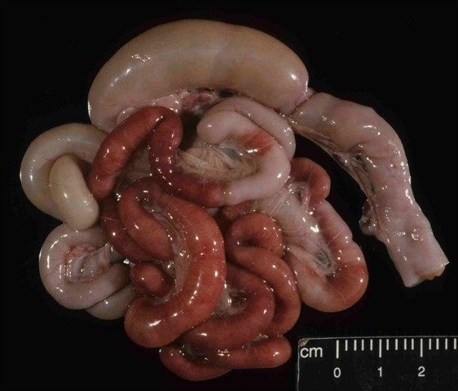
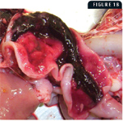
Small Intestine Images at
Necropsy

Slide 12
Prevention
All cats should be vaccinated
Protocol:
1st at 8 to 9 weeks of age
2nd 3 to 4 weeks later
Booster one year later
Revaccinations given at 3 year
intervals thereafter

Slide 13
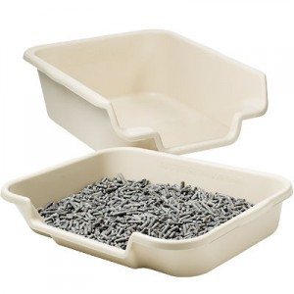

Decontamination
All contaminated cages, litter boxes, food & water bowls, shoes & clothing must thoroughly cleansed with bleach

Slide 14
Client Education
Feline Panleukopenia is a highly contagious & devastating disease
Kittens are extremely susceptible; high death rate
Affects cats of all ages
Is a multi-system disease
Characterized by diarrhea, vomiting, dehydration, anorexia, high fever, death
No cure
Preventable by appropriate vaccinations

Slide 15
References
Alleice Summers, MS, DVM. (2007) Common Diseases of Companion Animals (2nd ed.). St. Louis, MO: Mosby
Ian K. Barker DVM, PhD & Elizabeth S. Williams DVM, PhD (Eds.). (2001) Infectious Diseases of Wild Animals (3rd ed.). Ames, IA: Iowa State University Press
http://www.merckvetmanual.com/mvm/htm/bc/57100.htm
http://www.metro-vet.com/reference/panleukopenia.php
http://www.ncbi.nlm.nih.gov/pubmed/19481033
http://www.vet.cornell.edu/FHC/brochures/ZoonoticDisease.html
http://www.ivis.org/proceedings/abcd/abcd_fpv_guidelines.pdf

